Slide 1

Wireshark

Slide 2
Agenda
Introduction to Wireshark
Features
History of Wireshark
System Requirements
Wireshark UI
Capturing Data packets on Wireshark
Wireshark Filters
Wireshark Colorization option
Working with Captured packets

Slide 3
Introduction to Wireshark
What is Wireshark?
Open source
Purpose
Network administrators use it to troubleshoot network problems
Network security engineers use it to examine security problems
QA engineers use it to verify network applications
Developers use it to debug protocol implementations
People use it to learn network protocol internals

Slide 4
Features
Available for UNIX and Windows.
Capture live packet data from a network interface.
Import packets from text files containing hex dumps of packet data.
Display packets with very detailed protocol information.
Save packet data captured.
Export some or all packets in a number of capture file formats.
Filter packets on many criteria.
Search for packets on many criteria.
Colorize packet display based on filters.
Create various statistics.

Slide 5
History of Wireshark
Late 1997 Gerald Combs - Started implementing - Ethereal
Initial release - July 1998 as version 0.2.0
Gilbert Ramirez - contributed a low-level dissector to it.
In October, 1998 Guy Harris - better tcpview -started applying patches and contributing dissectors to Ethereal.
2006 - renamed to Wireshark
2008 - version 1.0 was released
2015 - version 2.0 was released

Slide 6
System Requirements for installing Wireshark
OS - Any Linux/Window OS
Minimum 1Gb ram
500mb disk space

Slide 7
Wireshark UI
Menu
Toolbar
Filter toolbar
Packet list pane
Packet Details pane
Packet Byte pane
Status bar

Slide 8
Capturing Data Packets on Wireshark
Select the interface you want to capture
Click the first button on the toolbar, titled “Start Capturing Packets.”
Wireshark starts Capturing packets
Click on the Stop button on the toolbar, titled “Stop Capturing Packets”.
Analyzing Data packets on Wireshark
No. - Order number of packet
Time - how long after you started the capture that this packet got captured.
Source - Source system address
Destination - Destination system address
Protocol - Type of protocol(packet)
Length - length of the packet
Info - more info about the packets

Slide 9
Wireshark Filters
2 Types of Filters
Capture filters - limit the captured packets by the filter
Ex: host 10.250.1.137
Display Filter - change the view of the capture during analysis.
Ex: ip.src==10.250.1.137

Slide 10
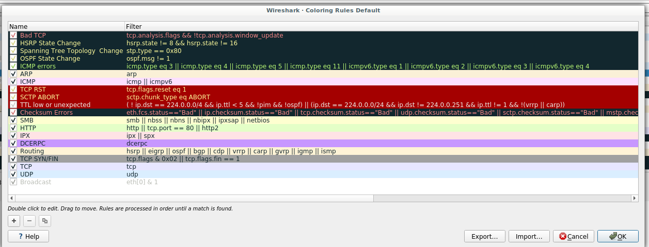
Wireshark Colorization Options
Goto view -> Coloring Rules

Slide 11
Working with Captured Packets
Capture the packets
Select the packet you want to analyze
Tree view displayed in Packet Details Pane
Pop-up Menu Of The “Packet List” Column Header
Pop-up Menu Of The “Packet List” Pane
Pop-up Menu Of The “Packet Details” Pane
Toolbar

Slide 12
Thank you

